Slide 1
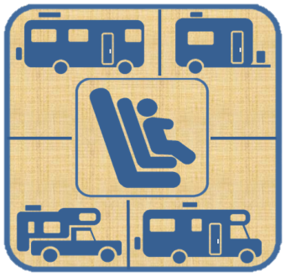
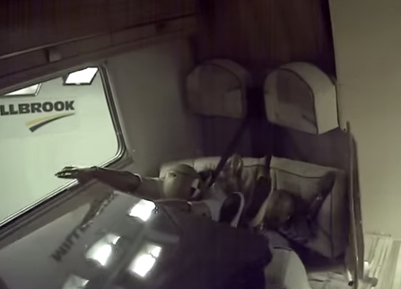
Recreational Vehicles & Child Occupants
Guidelines & recommendations to provide to parents
Lifesavers Conference, San Antonio, Texas
Workshop: Vacation Travel Risks & What Parents Need to Know
April 23, 2018
James DeCarli, PhD, MPH, PgDip, MPA, CPST
Pro Consumer Safety
Notes:
Background:
Researching transporting children safely in RV’s
2012-2014 SHSP OP
CPS Coordinator – calls from parents renting RV’s
Questions
Safe in RV’s?
Unanswered questions
Collaborating with agencies and organizations (NHTSA & RVIA)
Guidelines for parents
Recommendations for CPST’s
CPS state conferences
Safe Kids CEU Webinars in 2015 & will update in June 2018
Today I will discuss:
Risks of transporting children in RV’s
But also preventive recommendations

Slide 2
RV Facts & Demographics*
Nationwide 30 million RV enthusiasts (including renters)
RV ownership 8.9 million households
Average age 48 years
Largest increase of age category ages 35-54
39% of RV’rs have children under the age of 18 living at home
Class C is most commonly rented and owned
*Recreational Vehicle Industry Association (RVIA)

Slide 3
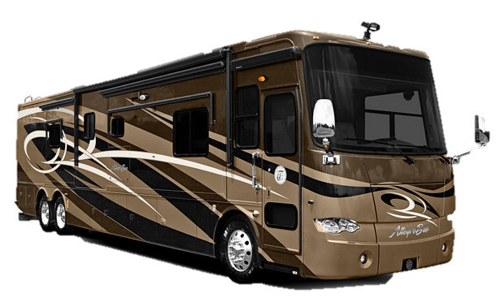
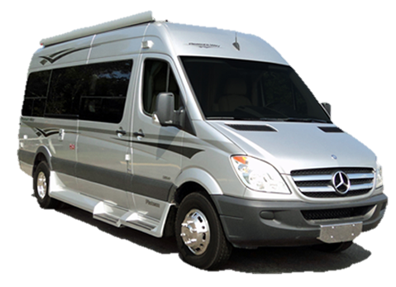
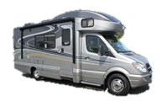
Classes of RV’s (Motorized)
Class A
Class B
Class C

Slide 4
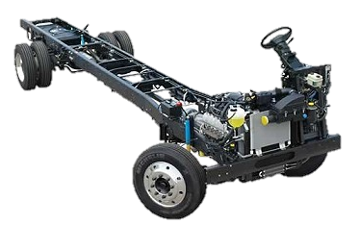
Class A
Largest of motor homes
Built on a bus chassis (not required to meet bus occupant safety standards for rear seating)
Weigh 15,000-30,000 pounds
Required to meet Federal seat belt standards for front occupants only. But not for rear occupants

Slide 5
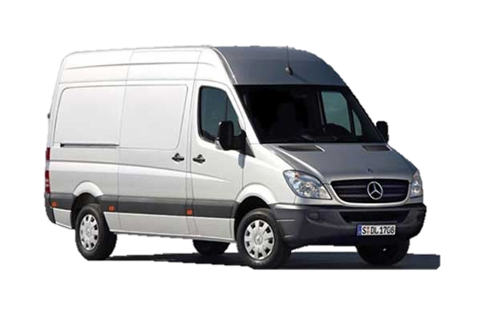
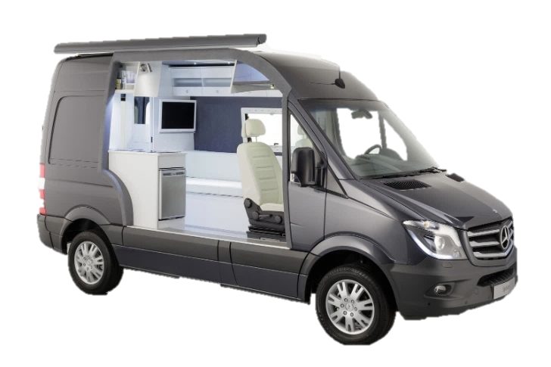
Class B
Van conversions
Weight 6,000-8,000 pounds
Required to meet Federal seat belt standard for front occupants and passenger testing but not for rear occupants for this weight class.
Some manufacturers meet Federal standards and do independent testing.

Slide 6
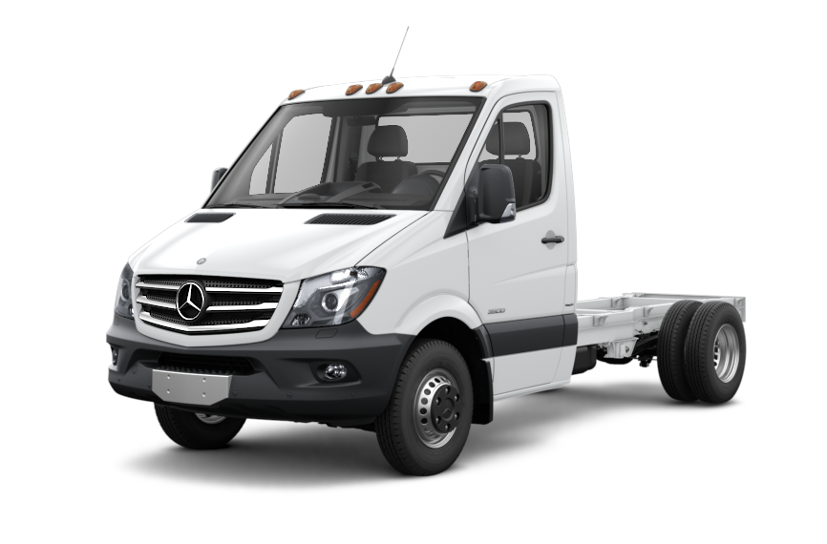
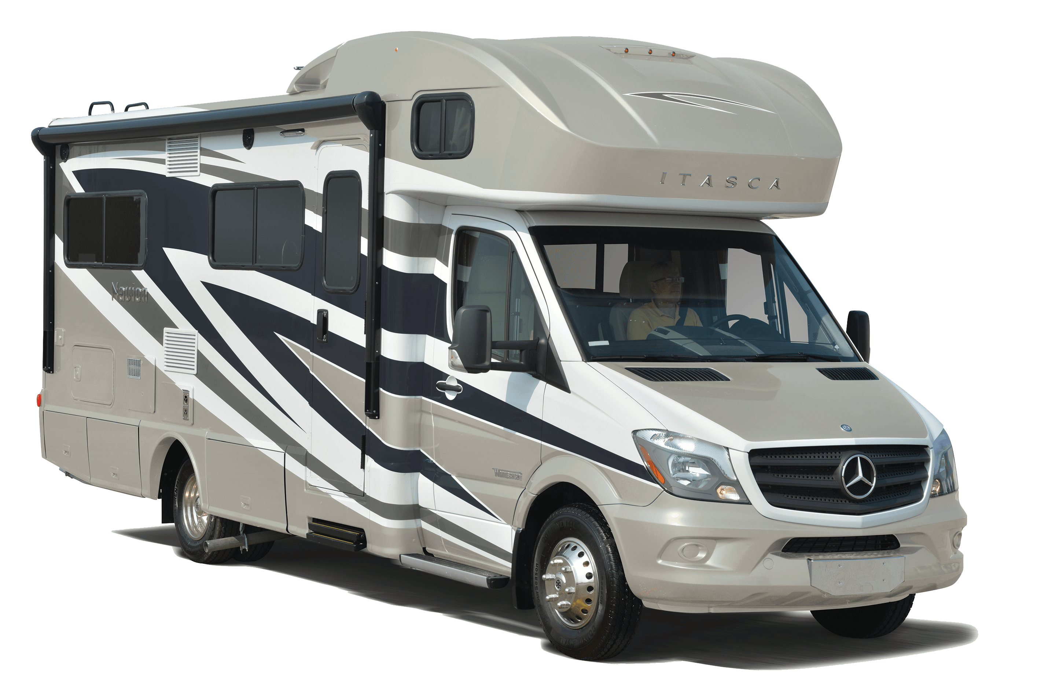
Class C
Constructed on a van chassis
Weight 10,000-12,000 pounds
Required to meet Federal seat belt standards for front occupants only. But not for rear occupants

Slide 7
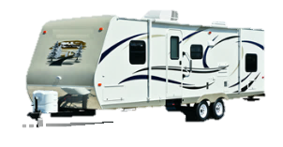
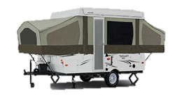
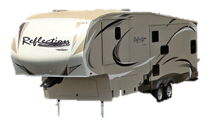
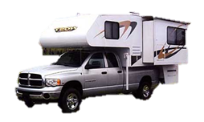
Other Types of RV’s (Non-Motorized, Towable)
Trailer
Tent Trailer
5th Wheel
Truck Camper

Slide 8
Federal Motor Vehicle Safety Standards & Regulations
(Title 49, Code of Federal Regulations, Part 571)
Standard No. 208 - Occupant Crash Protection Standard:
Type 1 (lap-belt only) or Type 2 (lap-shoulder belt)
Performance requirements for anthropomorphic test dummies
Passenger Cars, Multipurpose Passenger Vehicles, Trucks and Buses with a gross vehicle weight rating of 4,536 kg (10,000 lbs.) or less, and buses (driver's seat only)
EXCLUDES Class A and C RV’s due to exceeding 10,000 lbs.

Slide 9
Federal Motor Vehicle Safety Standards & Regulations
(Title 49, Code of Federal Regulations, Part 571)
Standard No. 208 - Occupant Crash Protection Standard:
Specifically for “Motor Homes” (Recreational Vehicles)²
Rear designated seats in motor homes are excluded from the rear lap/shoulder belt requirements
The rear seats in LTVs (Light Truck and Vans) carrying chassis-mount campers with a weight greater than 3,855 kg (8,500 lbs.) and no greater than 4,536 kg (10,000 lbs.) would need to be equipped with a lap belt only
Excludes Class B van conversions

Slide 10
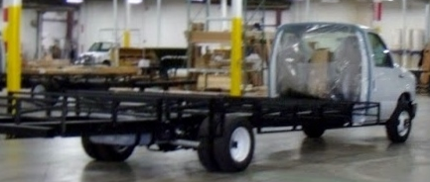
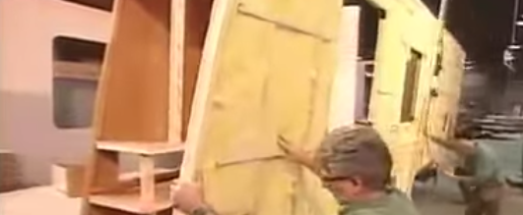
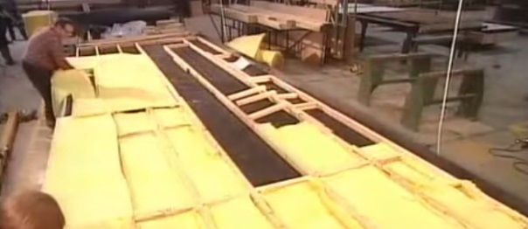
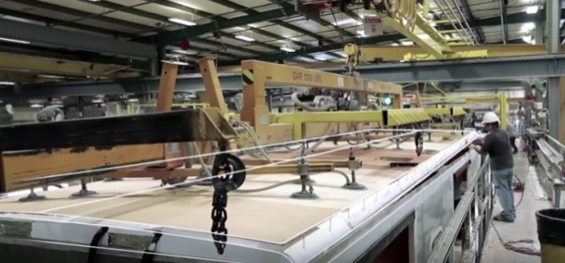
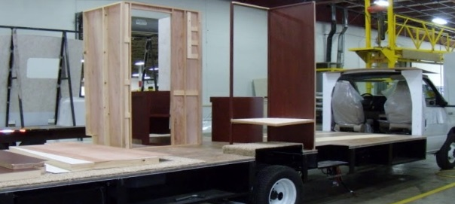
RV Construction Process & Material
1
4
Exterior
walls
Chassis
2
5
Flooring
Roofing
3
Cabinets/
Utility
Framing Materials:
Wood
Aluminum

Slide 11
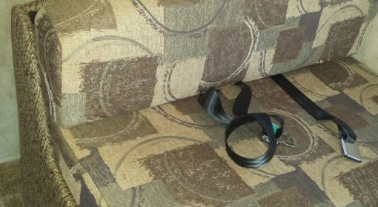
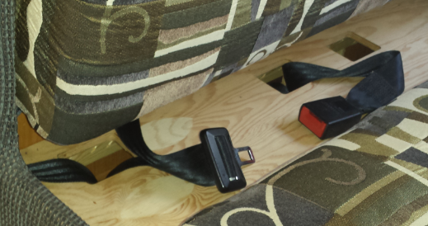
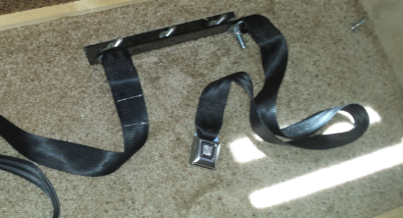
Rear Seat Belt Construction in RV’s
1
2
Older RV’s seat belts anchored to wooden joists
Currently: Anchored to vehicle chassis (frame)
3

Slide 12
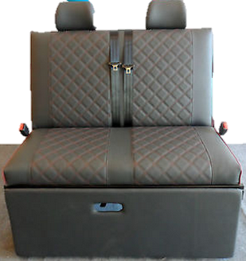
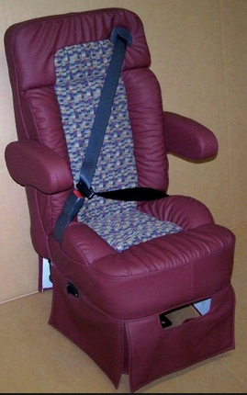
Rear Seat Belt Construction in RV’s
Seat belts look similar to those in passenger vehicles

Slide 13
Rear Seat Belt Construction in RV’s
Tethers
Installation instructions - Cruise America RV Rentals

Slide 14
RV Crash Estimates & Data
75,000 hospitalizations per year**
Limited data (hospitalization & fatality data)
Lack of standard definition:
RV, recreational vehicle, motor home, house car, camper car, etc.
2. Classification:
“Heavy Truck: Single vehicle or tractor-trailer combination designed for carrying a heavy load of property on or in the vehicle. Includes: single unit trucks (e.g., coal truck), tractor-trailers, motor homes, etc.” (PA DOT)
**Federal Motor Carrier Safety Administration (FMCSA)

Slide 15
RV Crash Dynamics
Cause of Crash | Collision Type | Injuries (all ages)
Underinflated tires | Rollover -most common from speeding & sharp turns | Head trauma
Poorly balanced weight | Sideswipes | Fractures
Tire blowout | Tilt | Cuts & lacerations
Overcorrection/ oversteering | Rear-end | Facial
Inexperienced drivers -generally no special training or licensing required for RV drivers |  | Spinal cord
Federal Motor Carrier Safety Administration (FMCSA)

Slide 16
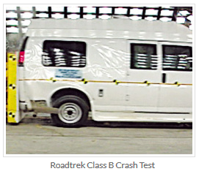
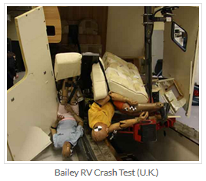
RV Crash Testing Status
NHTSA does not crash test RV’s (except Class B in 1970’s)
Roadtrech Motorhomes, Inc.
Class B
United States
Adult passengers
Not child occupant or CRS’s
Bailey Motorhomes
Class C
United Kingdom
Adult & child passengers in seat belts
Not CRS’s

Slide 17
Bailey Crash Tests
Video 1
Pre-
modification
Video 4
Pre-
modification
Video 5
Post-
modification

Slide 18
Video 1 (pre-modification)

Slide 19
Video 4 (pre-modification)

Slide 20
Video 5 (post-modification)

Slide 21
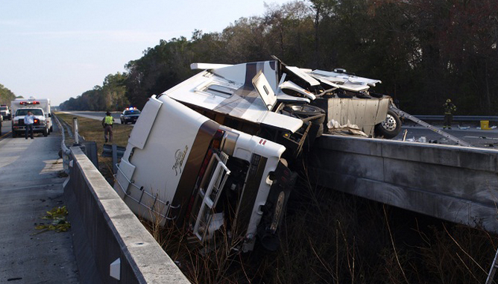
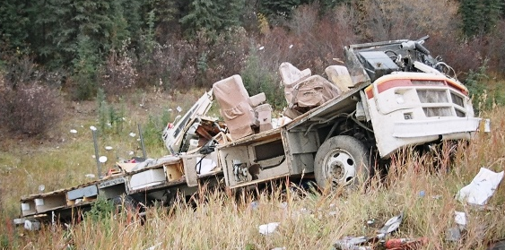
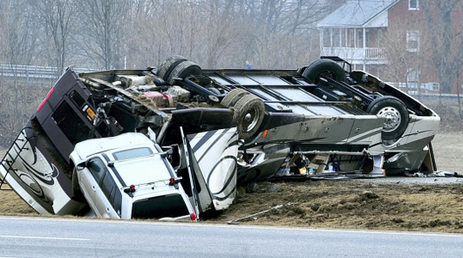
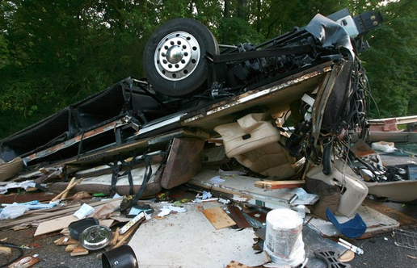
RV Crash Outcomes

Slide 22
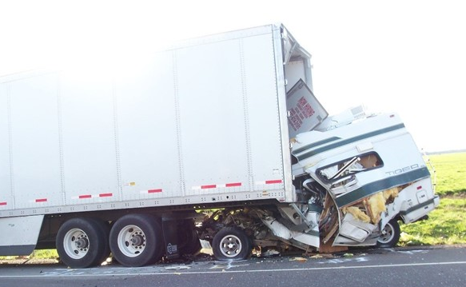
RV Crash 1
Class B
RV crashed into parked semi-trailer
Fatality: Both front passengers died at scene, 5-year old child rescued
Oregon Feb 25, 2016
http://www.kgw.com/article/news/local/osp-trooper-rescues-girl-5-from-burning-motor-home-after-fatal-crash/283-56424492

Slide 23
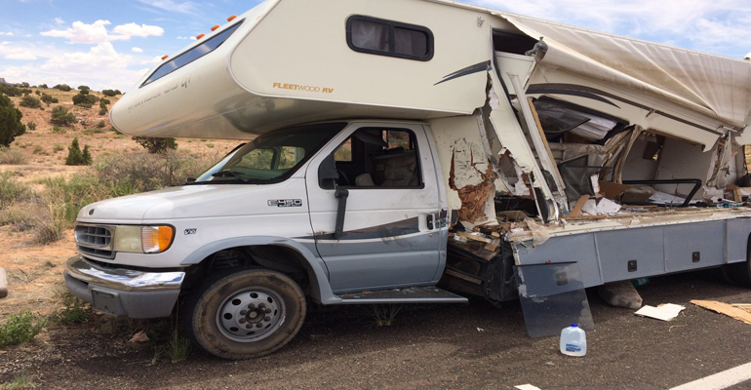
RV Crash 2
Class B
Commercial vehicle collides with motorhome
Fatality: 2-thirteen year old boys in rear of RV
June 28, 2016
https://arizonadailyindependent.com/2016/06/28/thirteen-year-old-boys-killed-when-commercial-vehicle-crashes-into-motorhome/

Slide 24
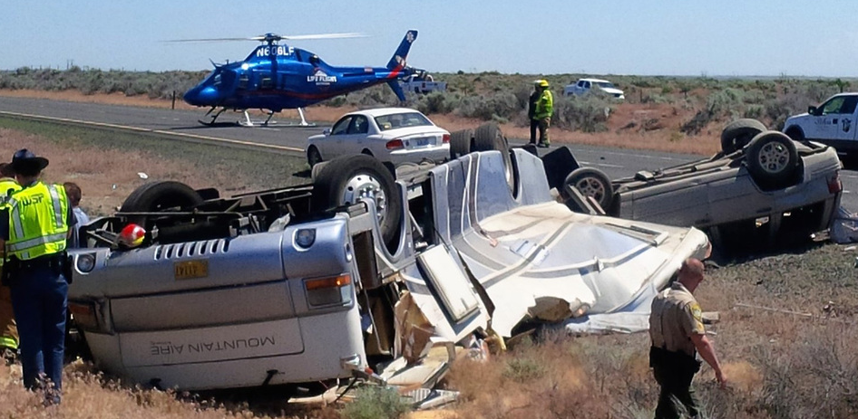
RV Crash 3
Class A
Driver of RV swerved, overcorrected rolled into median
Injury: Severe
Washington, may 29, 2017
http://www.ifiberone.com/news/oregon-man-critically-injured-in-motorhome-crash-on-i-/article_9290f4b6-44e0-11e7-bc40-d35c2a08b347.html

Slide 25
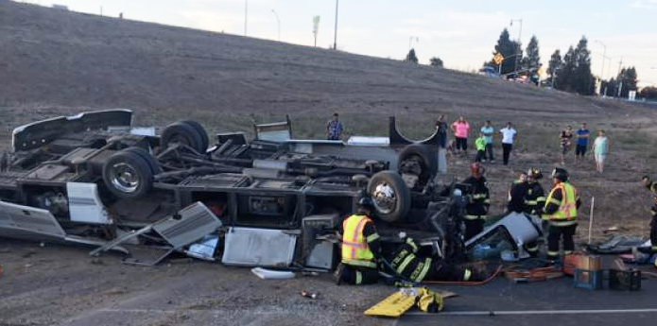
RV Crash 4
Class A
Driver of RV cut off by another vehicle
Injury: non-fatal hospitalization 3-passengers
California, October 9, 2016
https://rvtravel.com/brutal-crash-obliterates-motorhome/

Slide 26
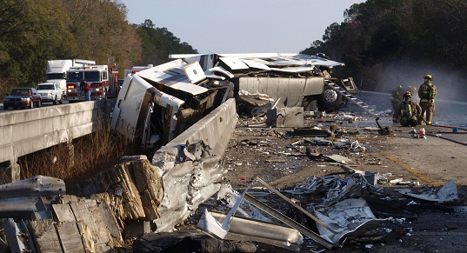
RV Crash 5
Class A
Tire blowout
Hit guardrail & overturned
Florida, January 27, 2011
http://flaglerlive.com/16920/i95-rv-crash/

Slide 27
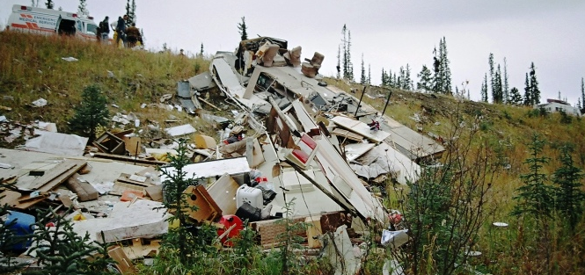
RV Crash 6
Class A
Early morning loss of control & overturned
http://www.marshlakeyukon.net/FireRescue/2008/Sept282008RVCrash.htm

Slide 28
RV Crash 7
Class A
Loss of control
http://www.rv.net/forum/index.cfm/fuseaction/thread/tid/27598439/srt/pa/pging/1/page/1.cfm

Slide 29
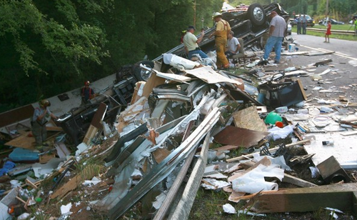
RV Crash 8
Class A
Loss of control
http://www.independentmail.com/news/local-news/motor-home-accident-abbeville-highway

Slide 30
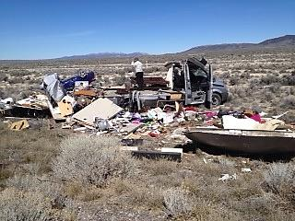
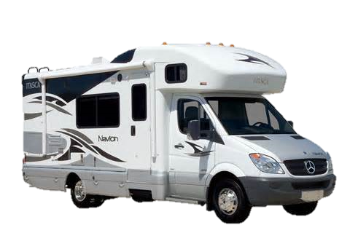
RV Crash 9
Class C
Loss of control after car strikes RV while trying to pass
http://livingstingy.blogspot.ca/2014_04_01_archive.html

Slide 31
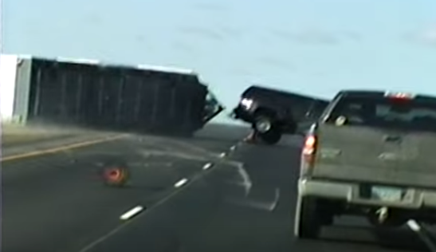
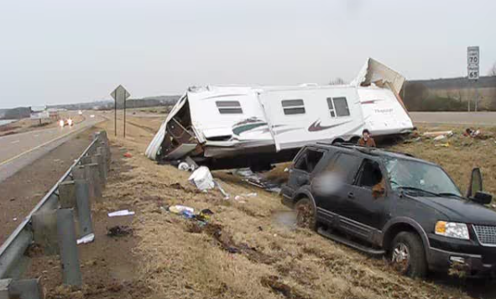
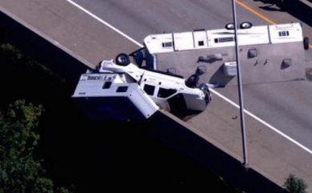
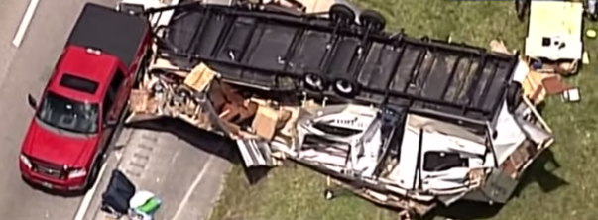
Non-Motorized Towable RV Crashes
Trailer
Tent Trailer
5th Wheel
Truck Camper

Slide 32
Non-Motorized Towable RV Crash Outcomes
Seat belts that meet Federal Occupant Standards
Notes:
There is a commonality among these non-motorized, towable RV’s, all of which is that of passengers are transported in passenger vehicles.
During a crash some trailers engulf the vehicle, but yet the passengers still are safer in the passenger vehicle, as compared to being in the rear of one of the three classes of motorized RV’s.
When we visited factories of RV’s whether its motorized, Class A, B or C, or even non-motorized RV’s what was clear was the high amount of engineering that goes into their construction. As many say “they are built like a house”. Even those Class A’s that weight well over 50,000 pounds that cost into the millions of dollars. And many are built solid and like a home. Just they are not designed to withstand a crash. And of course they are not crash tested so nobody really knows the outcome.
But even like a solid build home that if moved from one location to another, are moved carefully because one quick stop, the home keeps moving and will likely collapse. Now I am not comparing the construction of the RV to that of a home but rather using this comparison to illustrate that even though these are build solid, when moving down the highway, upon a collision as we observed from the crash testing and crash dynamics, if a passenger is in the rear seating, can increase the risk of severe injury or death.
Of course while in a child restraint system a child would have more protection than without but as technicians we do not want a parent to have a false sense that their child will be safe.
These are built like a home. But when moving a home on a roadway goes slowly and takes a long time for breaking. If it had to make a sharp turn or stop quickly the home would continue to follow. Just like with the RV the only difference is with the RV the risk is when passengers are inside.

Slide 33
OVERVIEW Injury Risks Rear-Seated RV Passengers
RV's are not required to:
Have rear occupant crash testing or
Meet Federal seat belt standard 208 for rear seating.
2. Even though rear bench seats have seat belts anchored to the RV chassis, during a collision, the wooden bench supports can collapse
Kitchen equipment, interior walls and cabinets even when anchored onto the RV Chassis, during a collision, increases the risk of collapsing or becoming a projectile.
Storage supplies can also become projectiles
Notes:
So now that we have learned of what occurs during:
Crash testing, and
Crashes
And understand that RV’s are not crash tested and do not need to meet Federal seat belt standards
As CPS Technicians are we confident to suggest to a parent on the safety of transporting a child in an RV? Or should we as Technicians be recommending a child to be transported in these vehicles? Will we want to take that responsibility or should we?

Slide 34
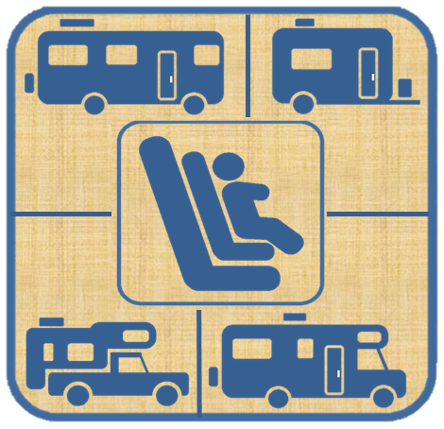
Guidelines for Parents
Three alternatives to consider
Before traveling with a child in an RV
Notes:
What these guidelines do it put the answer to many of these into the hands of the parents.
Parents need to be able to make their own decision based upon the facts. After all we are not here to suggest not to use a specific RV with a child passenger anyway, but rather provide them what is safest.
Before I established these guidelines, I also took time to interview parents and RV owners, reviewed many RV blogs and RV manufacturers on this issue. Interestingly among bloggers, many responders question why RV manufacturers are not crash tested in the U.S.
Many parents simply want to know, what do I need to know and do to keep my child safe. So these guidelines, not fully complete, but a start to help clear the way of this gray area, helps us technicians to more effectively help parents make the safest choice.

Slide 35
Explain to Parents
RV’s are not crash tested
Rear RV seating-not required to meet Federal seat belt requirements
If choosing an A, B or C Class, never install a car seat or booster seat on a rearward- or side-facing RV seat
During a crash:
Even when belted, seat benches can collapse
Kitchen equipment & cabinets can become projectiles
Other safety tips:
Never leave a child alone in an RV
Risks-infants & toddlers (falls, burns, suffocation, poisoning, etc.)

Slide 36
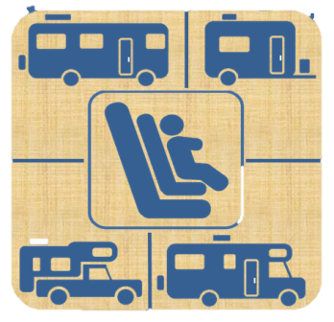
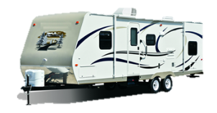
1. Best Alternative
Rent or purchase a non-motorized, tow-able RV”, so the child can ride safely while properly restrained in a passenger vehicle that is pulling the RV.
Ensure driver is experienced and familiar with towing a trailer
Reminder: High-profile vehicles are restricted in high winds, inclines, braking, and have risks making sharp turns and backing
Fifth Wheel Trailer Tent Trailer Truck Camper

Slide 37
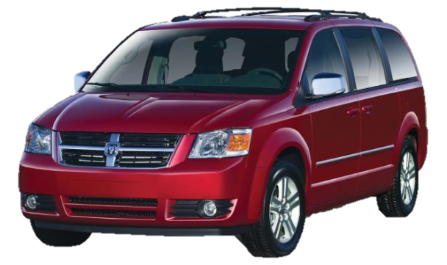
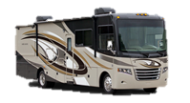
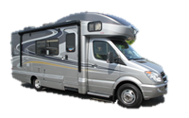
2. Second Best Alternative
Drive with the child properly restrained in a passenger vehicle and follow the RV
Class A Class B Class C

Slide 38
3. Least Best Alternative
For those with a personal RV, have custom captain chairs that comply with Federal seat belt standards installed*
Risk of cabinets and kitchen equipment anchored into the wooden flooring and joists which can break apart during a collision
Other storage items becoming projectiles
*Never install a car seat or booster seat on a rearward- or side-facing RV seat

Slide 39
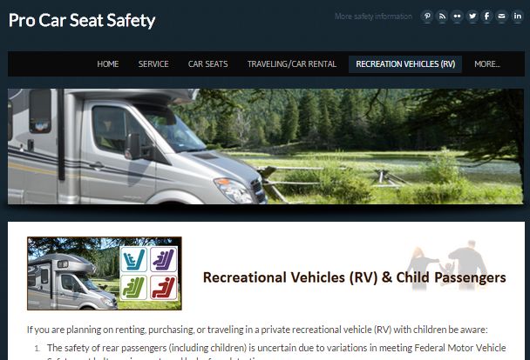
Educational Resources for Parents
WEBSITE
http://www.procarseatsafety.com/recreation-vehicles-rv.html

Slide 40
Educational Resources for Parents
HANDOUTS
www.procarseatsafety.com/health-education.html

Slide 41
Resources for CPST/CPSTI’s
FACT SHEET
http://www.procarseatsafety.com/rv-resources-cpsts.html

Slide 42
Contact
James (Jim) DeCarli
jdecarli@ProConsumerSafety.com
(323)491-6197

